Slide 1
MP Expenses Analysis
Data from 2013/14 to 2022/23
Excludes Winding-Up budget and spend
“Travel & Substance” costs are uncapped for non-London MPs
“Other” costs are uncapped for all MPs

Slide 2
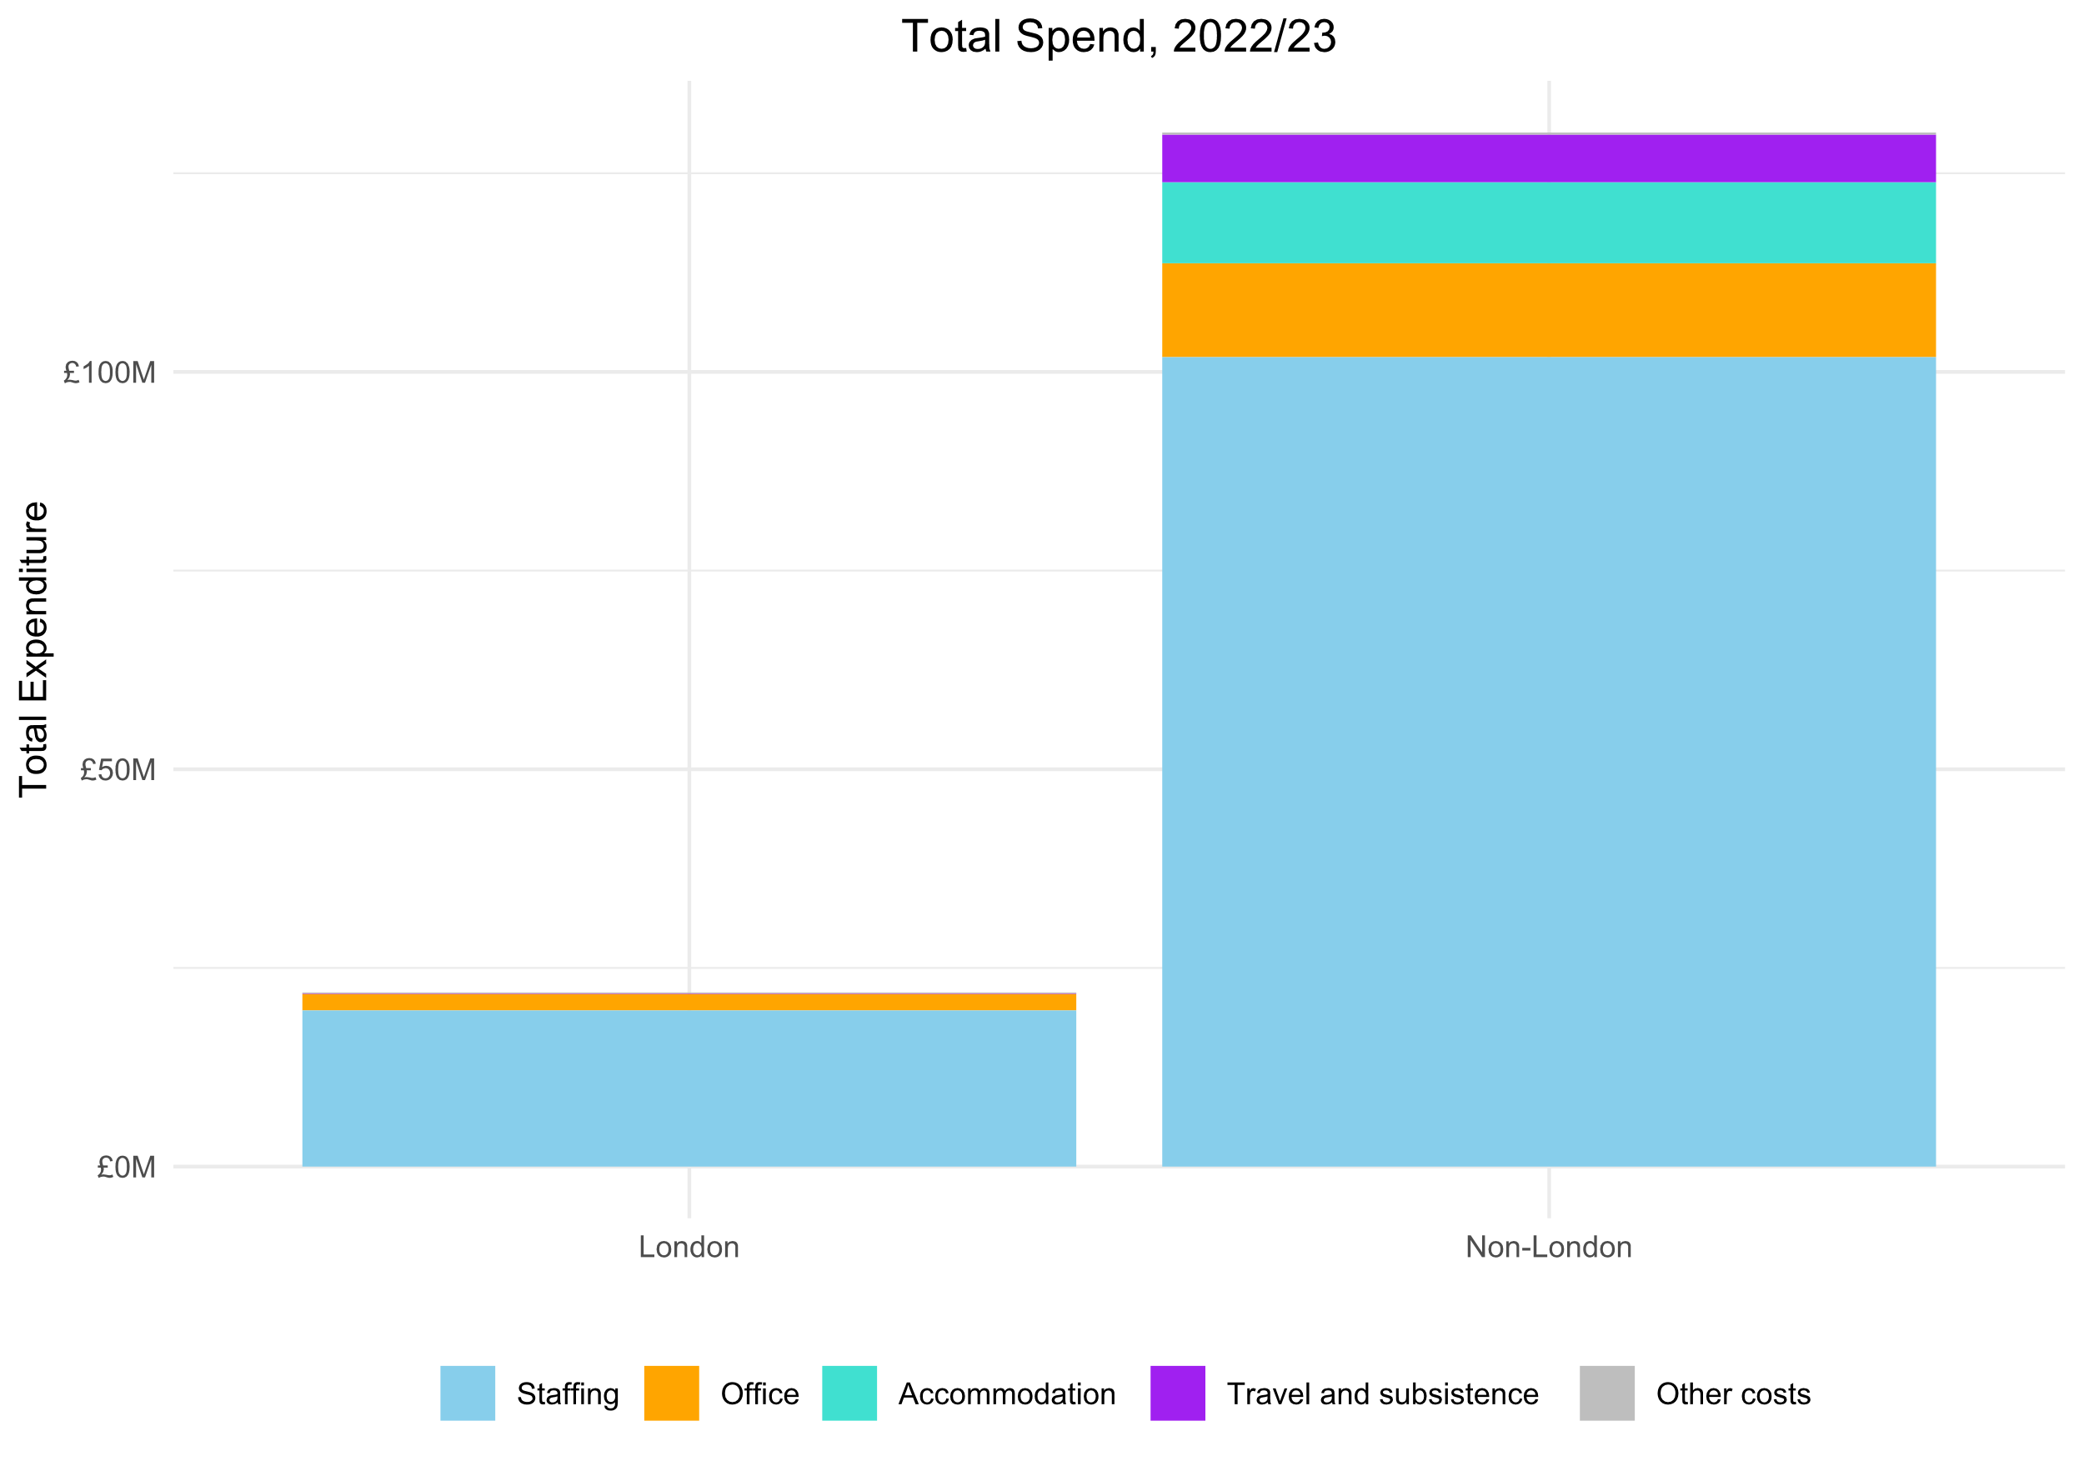
What was the total spent by MPs?
MP expenses totalled £152,044,656 in 2022-23
…of which £21,921,694 (14.4%) was attributed to those based in London

Slide 3
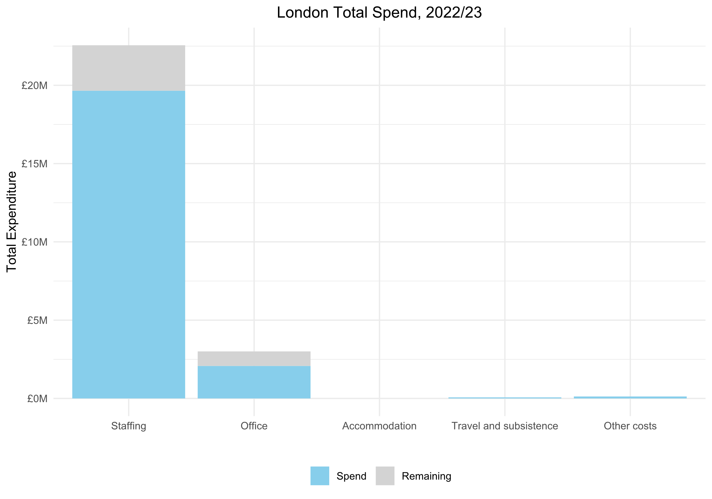
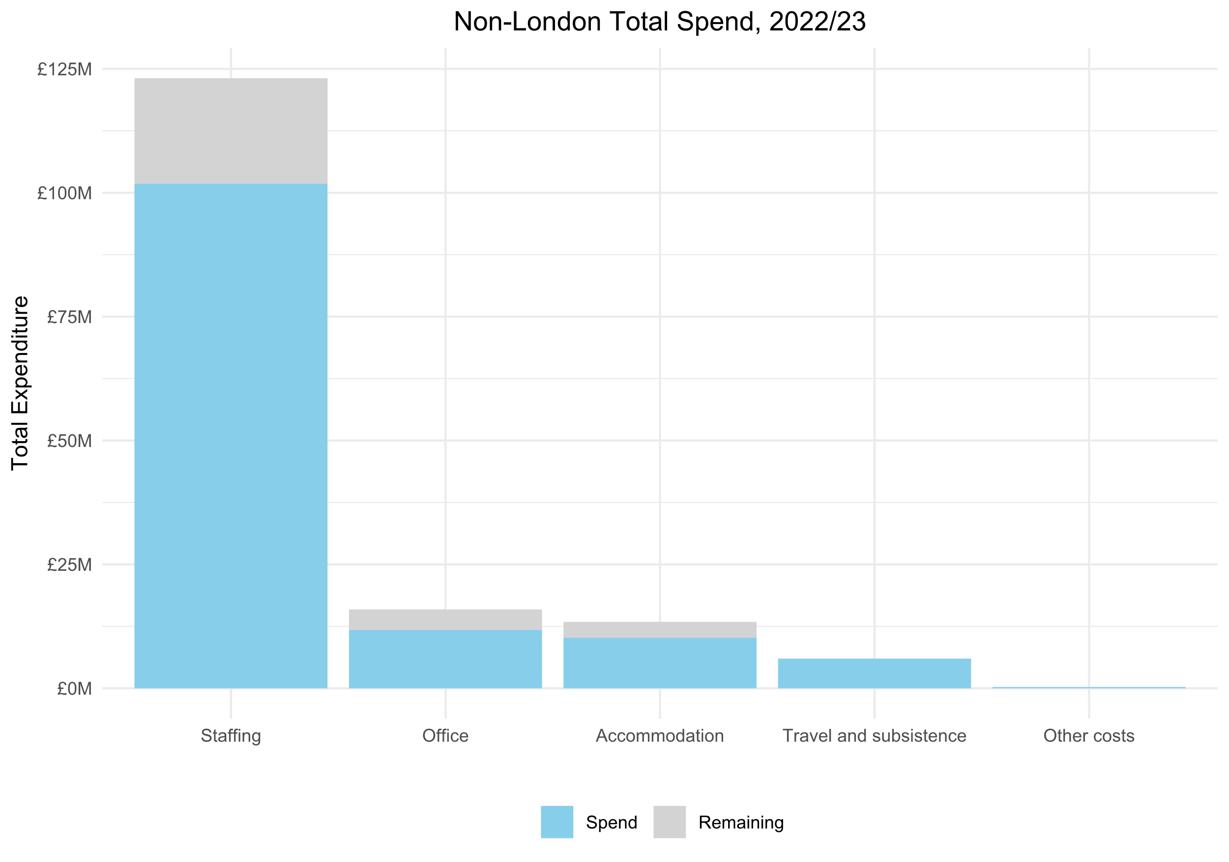
Do MPs use all of their budget?

Slide 4
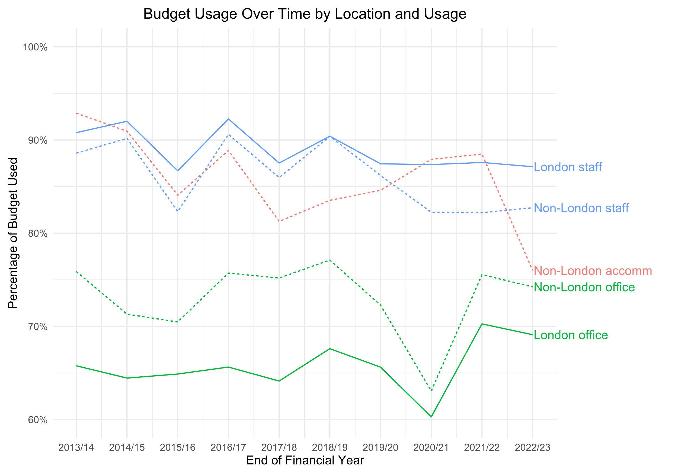
How has this changed over time?
Regular underspend of office budget
Accommodation usage at record low
Slow decline of staff usage since 2013/14

Slide 5
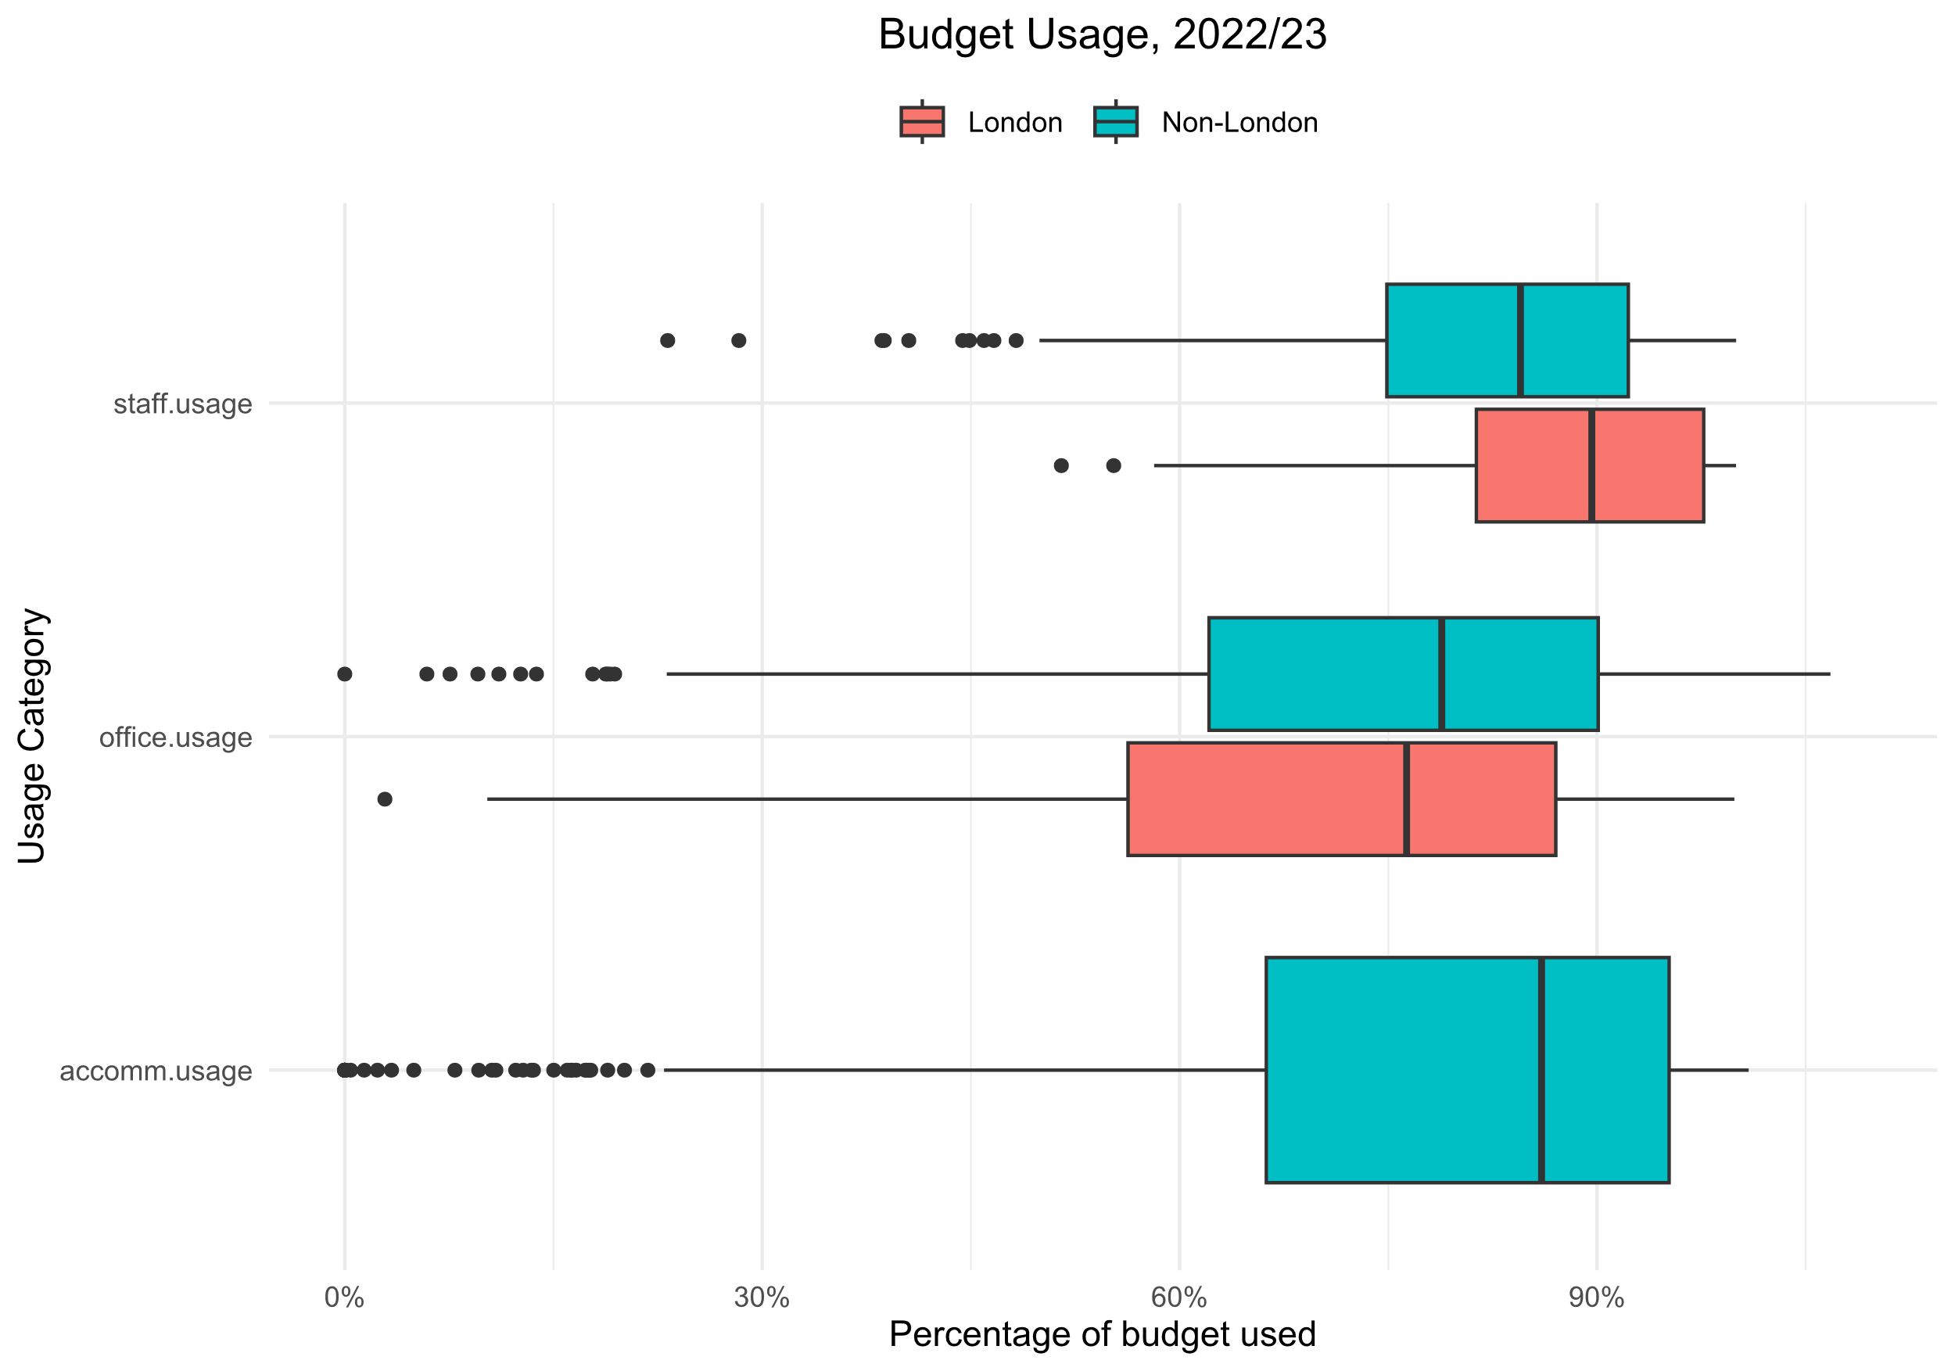
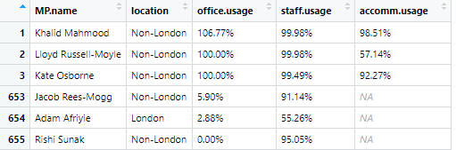
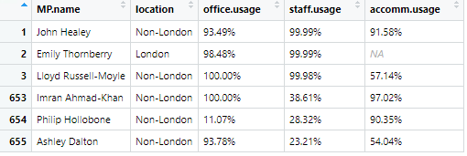
MP deep dive

